Slide 1
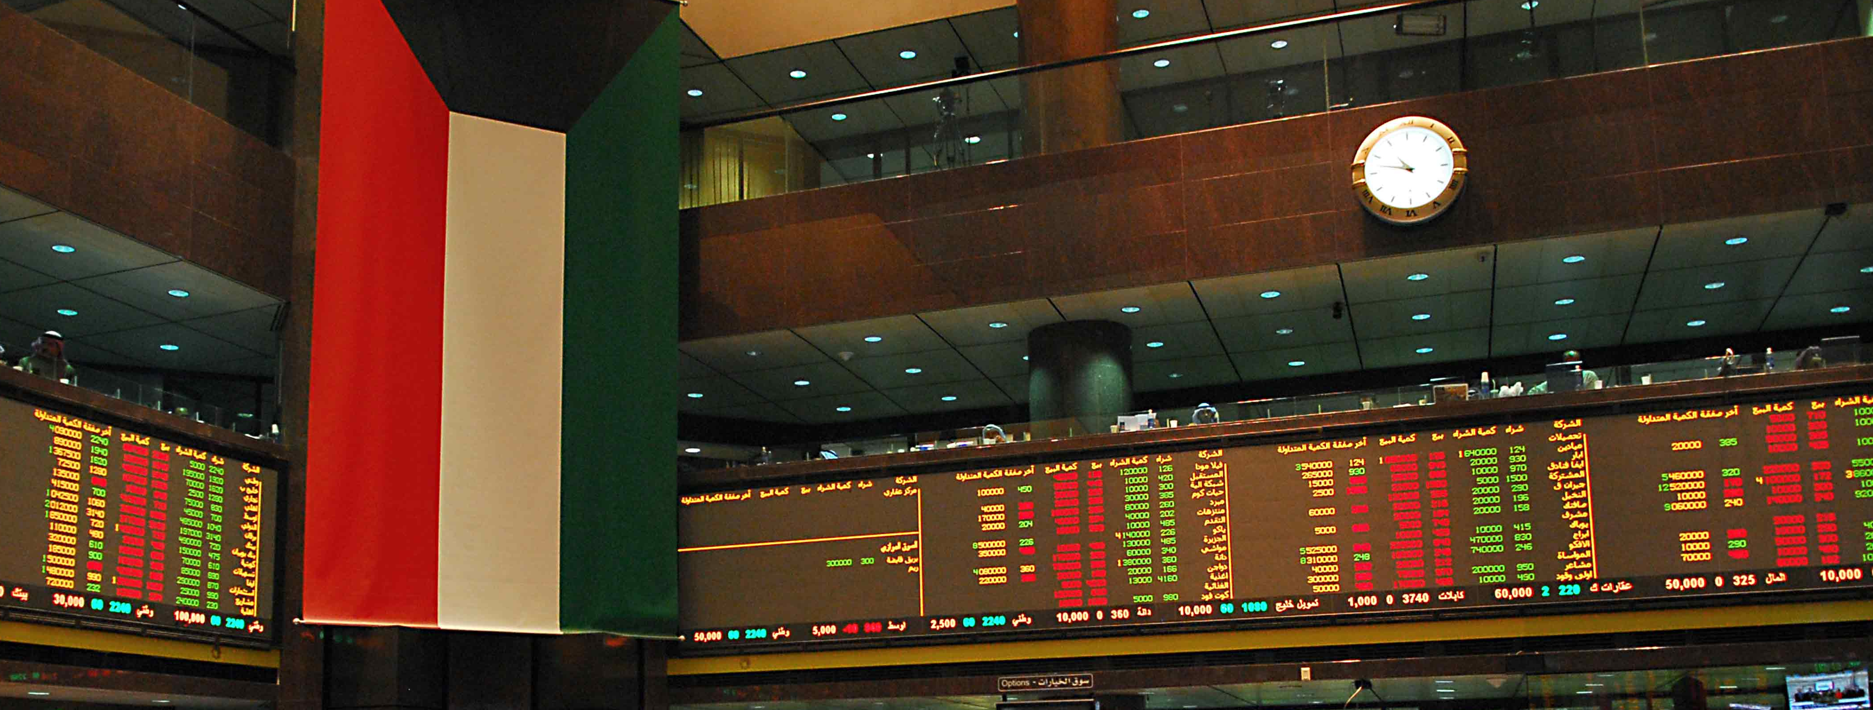

Recent Initiatives to Develop the Kuwaiti Capital Market and Index Upgrades
May 2019 – Presentation to Kuwait University
Abdulrahman Y. Al-Failakawi
Director – Markets Regulation Department

Slide 2



Background – CMA, BK and KCC
Securities Regulator
Stock Exchange
Clearing
+
CSD

Slide 3




How do they work together?
Exchange Member
Buy order
Sell order
Exchange Member
Exchange
Clearing agreement
Clearing agreement
Trade details
Exchange Member
Deliver cash
Deliver shares
Exchange Member
Kuwait Clearing Company
Obligations cleared
Settlement details
Securities transfer instructions
CSD Member
CSD Member
Central Securities Depository
(CSD)

Slide 4
Market Development Program - Key Objectives
Overview
Key Objectives
How did it start? Gap analysis ➔ Major reforms needed in post-trade
Exchange (Boursa Kuwait) related initiatives channeled through one market development project.
Due to the overall size and nature, changes will be implemented in four phases.
Two Phases have been launched so far. Subsequent phases are expected to be completed in 2019 and 2020.
  Upgrade clearing & settlement practices to be in line with international standards
  Support the introduction of more sophisticated financial instruments and investment products
  Diversify investor base, by attracting more foreign institutional investors
  Improve the recognition of the market ➔ seeking EM upgrades by FTSE, MSCI, and S&P DJI.

Slide 5
Main Gaps before the Development Program
No DvP
Forced Settlement
Defaults
Slow Information Flow
Closing Auction
Account Opening
Corporate Actions
Transaction Costs

Slide 6
Transformation of the Capital Markets Under CMA Supervision
Market develop-ment 2
Exchange license
FTSE Emerging Market
Market segments (premier, main and auction)
New indices
Circuit Breakers
The CMA awarded the exchange license to Boursa Kuwait enabling independent operation of the exchange
FTSE announced the upgrade of Kuwait to secondary emerging market status
April 2019
Apr 2018
Establishment of CMA
CMA amended Executive Bylaws
Kuwait established the Capital Market Authority (CMA)
The goal was to create a world-class regulatory authority for the local capital market
CMA issued comprehensive, revised executive bylaws which regulate all security activities and its related aspects
Sep 2017
May2017
Oct 2016
IOSCO member
2015
CMA announced its IOSCO membership
Jun 2014
Market develop-ment 1
1983
2010
Go-live of first phase of market development efforts:
T+3 settlement cycle
Reduced tick size
New auction mechanism
International-style corporate actions timetable
Foundation of Kuwait Stock Exchange (KSE)
Incorporation of Boursa Kuwait
Market development 3.1
CMA established Boursa Kuwait to replace KSE and upgrade the existing market infrastructure
extended short-selling STP collateral management
Trade at Last Session
REITs
Founded in 1983, the oldest stock exchange in the region

Slide 7
Next Phases of Implementation
Live
Live
Live
Partial launch
To start in 2020
Market Development 1
Market Development 2
Market Development 3
Market Development 4
  Unified T+3 settlement cycle for all participants
  Custodian rejection facility
  Broker/ custodian collateral
  SLB / short-selling for maker makers
  Reduced tick sizes
  International-style corporate actions timetable
  New auction mechanism
  Buy-in board, with roll-over and cash close-out
  Late confirmation for Custodian rejections
  Market segmentation with new indices
  Circuit breaker
  OTC platform (separate launch)
  Off-Market trades enhancement (automation)
  Cash settlement - central bank (tbc)
  Qualified brokers as preparation for clearing membership model
  CCP – Cash
  Collateral management - STP
  Extended SLB/ short-selling
  Sub-accounts identification for omnibus accounts
  Repos
  Margin lending
  Risk waterfall model (brokers model)
  CCP – Derivatives
  Introduction of new products, Sukuks and Bond, ETFs and derivatives
  Clearing membership structure to replace QBs and NQBs
  Enhanced risk waterfall model (clearing members model)

Slide 8
Agenda
1- Market Development-1 Changes (Phase 1);
2- Market Development-2 Changes (Phase 2);
3- Market Development-3.1 Changes (Phase 3);
4- Country Classification;
5- Q&A.

Slide 9





Overview of Main Aspects of MD-1 Scope
1
2
3
T+3
settlement cycle
Custodian approval / rejection of trade validity and payment
Enhanced default procedures
0
1
2
3
T
S
Confirmation
4
Measures to enhance liquidity (SLB/ short-selling for market makers, new tick sizes)
5
International-style corporate actions timetable
6
Randomized Closing Auction

Slide 10
Overview of Main Aspects of MD-1 Scope
1
2
3
T+3
settlement cycle
Custodian approval / rejection of trade validity and payment
Enhanced default procedures
0
1
2
3
T
S
Confirmation
4
Measures to enhance liquidity (SLB/ short-selling for market makers, new tick sizes)
5
International-style corporate actions timetable
6
Randomized Closing Auction

Slide 11
Closer Look: Settlement Cycle
What is settlement?
What do we mean by settlement cycle?
What was the practice before May 2017?
Why T+3?

Slide 12
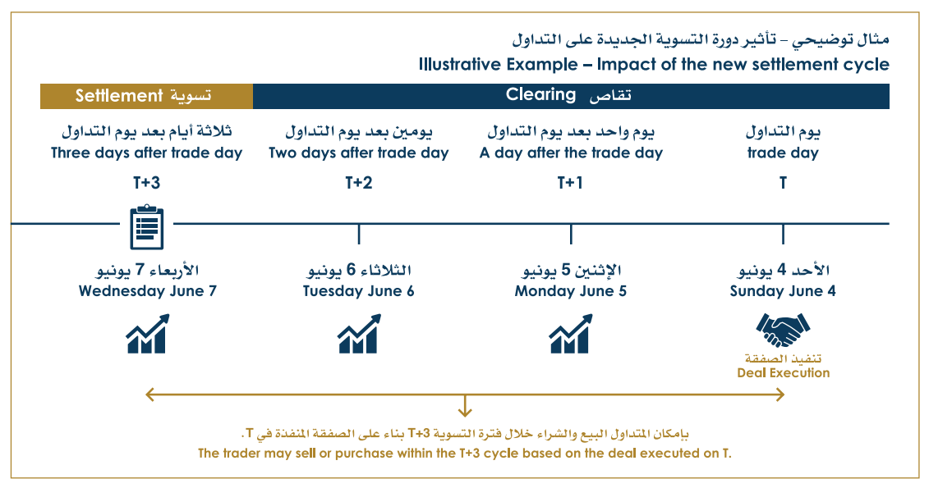
Example: T+3 Settlement Cycle

Slide 13

Overview of Main Aspects of MD-1 Scope
1
2
3
T+3
settlement cycle
Custodian approval / rejection of trade validity and payment
Enhanced default procedures
0
1
2
3
T
S
Confirmation
4
New tick sizes
5
International-style corporate actions timetable
6
Randomized Closing Auction

Slide 14
Overview of Main Aspects of MD-1 Scope
1
2
3
T+3
settlement cycle
Custodian approval / rejection of trade validity and payment
Enhanced default procedures
0
1
2
3
T
S
Confirmation
4
New tick sizes
5
International-style corporate actions timetable
6
Randomized Closing Auction

Slide 15
Overview of Main Aspects of MD-1 Scope
1
2
3
T+3
settlement cycle
Custodian approval / rejection of trade validity and payment
Enhanced default procedures
0
1
2
3
T
S
Confirmation
4
New tick sizes)
5
International-style corporate actions timetable
6
Randomized Closing Auction

Slide 16
Closer Look: Reduces Tick Sizes
Price range (fils)
from | to | Tick movement (fils)
1 | 50 | 0.5
51 | 100 | 1
102 | 250 | 2
255 | 500 | 5
510 | 1000 | 10
1020 | 2500 | 20
2520 | 5000 | 20
5050 | 9900 | 50
Price range (fils)
from | to | Tick movement (fils)
1 | 100.99 | 0.1
> 101 | - | 1
Example:
Example:
Best Ask
950
 | 940
 | Best Bid
Best Ask
946
 | 945
 | Best Bid
10 fils - Spread
Potential cost of trade 1.06%!
1 fils - Spread
Potential cost of trade 0.11%

Slide 17
Overview of Main Aspects of MD-1 Scope
1
2
3
T+3
settlement cycle
Custodian approval / rejection of trade validity and payment
Enhanced default procedures
0
1
2
3
T
S
Confirmation
4
New tick sizes)
5
International-style corporate actions timetable
6
Randomized Closing Auction

Slide 18


Closer Look: New Corporate Actions Mechanism
Cum-Div Date
Record Date
Payment Date
Ex-Div Date
4 important dates!
T-3
T-2
Cum-Div
Date
Ex-Div Date
AGM:
Cash/Stock Dividends
Issuer Announcement:
Record Date, Payment Date
Record Date
Adjustment in price by the Exchange and Data Vendors

Slide 19
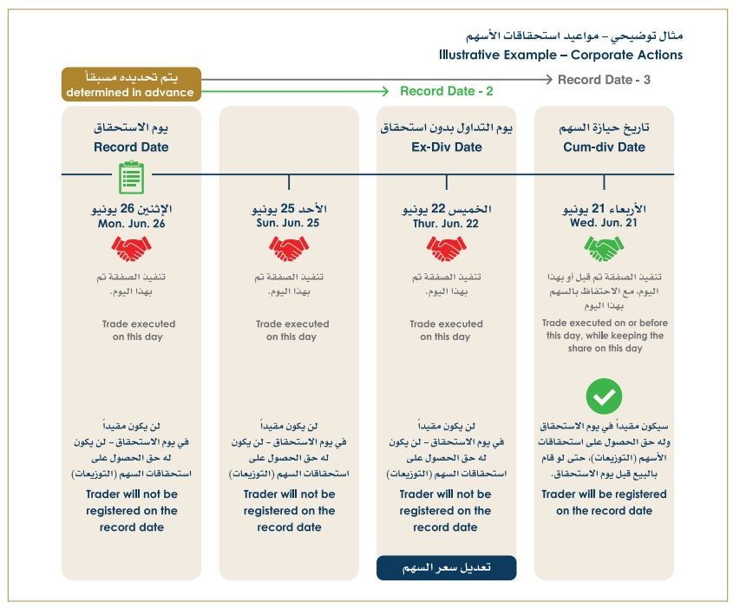
Example: Corporate Actions Timetable

Slide 20
Overview of Main Aspects of MD-1 Scope
1
2
3
T+3
settlement cycle
Custodian approval / rejection of trade validity and payment
Enhanced default procedures
0
1
2
3
T
S
Confirmation
4
New tick sizes)
5
International-style corporate actions timetable
6
Randomized Closing Auction

Slide 21
Agenda
1- Market Development-1 Changes (Phase 1);
2- Market Development-2 Changes (Phase 2);
3- Market Development-3.1 Changes (Phase 3);
4- Country Classification;
5- Q&A.

Slide 22
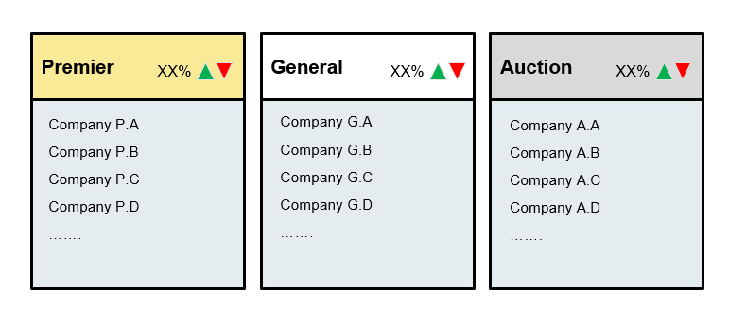
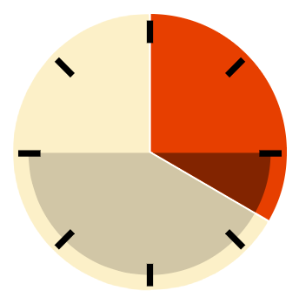


Overview of Main Aspects of MD-2 Scope
1
Buy-in Board
2
3
Market Segmentation/New Indices
Circuit breakers
T+3 general security board
T+1 special buy-in board
Main
4
OTC platform for non-listed securities
5
Off-Market trades processing streamlined through automation

Slide 23
Overview of Main Aspects of MD-2 Scope
1
Buy-in Board
2
3
Market Segmentation/New Indices
Circuit breakers
T+3 general security board
T+1 special buy-in board
Main
4
OTC platform for non-listed securities
5
Off-Market trades processing streamlined through automation

Slide 24
Overview of Main Aspects of MD-2 Scope
1
Buy-in Board
2
3
Market Segmentation/New Indices
Circuit breakers
T+3 general security board
T+1 special buy-in board
Main
4
OTC platform for non-listed securities
5
Off-Market trades processing streamlined through automation

Slide 25
Closer Look: Market Segmentation
New listing requirements
 | Premier Market | Main Market
Fair value of shares (not owned by controlling shareholder) | KD 45m | KD 15m
Minimum number of shareholders | 450 | 225 | 450
Minimum ownership for each of the minimum # of shareholders | KD 10,000 | KD 10,000 | KD 5,000
Years in operation | 7 | 3
Premier market requirements are more restrictive.
New listing requirements target companies with:
  Proven track record in terms of operation;
  Adequate free-float (to allow more liquidity on their shares)

Slide 26
Closer Look: Market Segmentation
Continuous requirements
 | Premier Market | Main Market
Liquidity | Should meet the minimum threshold, announced by BK each year.
Average market capitalization | Should meet the minimum threshold, announced by BK each year. | No requirement
Average price level - (price/par value) ratio | Shouldn’t fall below par value (100 fils) on average during the year. | No requirement
Analyst conference | Should be held quarterly | No requirement
Compliance with rules | No pattern in committing violations | No requirement
Disclosures and announcements | Arabic and English | No requirement

Slide 27
Closer Look: Market Segmentation
Process:
  Annual review;
  Watch lists (2-year);
    Premier Market Watch List
    Premier Market Breach Watch List
  Promotion or demotion (meet requirements over 2 years).
Market cap
Price level (price/par)
Liquidity

Slide 28
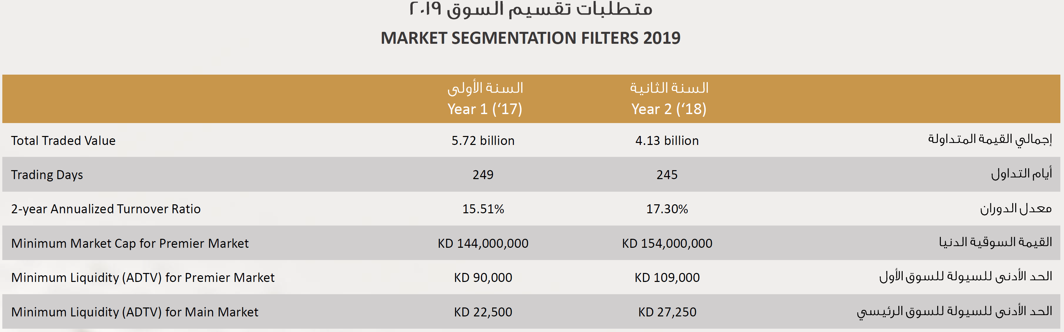
Closer Look: Market Segmentation
Source: Boursa Kuwait

Slide 29
Closer Look: Market Segmentation
# No | Ticker | Name | Sector | Market Segment
1 | NBK | NATIONAL BANK OF KUWAIT | BANKS | Premier Market
2 | GBK | GULF BANK | BANKS | Premier Market
3 | KIB | KUWAIT INTERNATIONAL BANK | BANKS | Premier Market
4 | BURG | BURGAN BANK | BANKS | Premier Market
5 | KFH | KUWAIT FINANCE HOUSE | BANKS | Premier Market
6 | BOUBYAN | BOUBYAN BANK | BANKS | Premier Market
7 | KPROJ | KUWAIT PROJECTS COMPANY (HOLDING) | FINANCIAL SERVICES | Premier Market
8 | MABANEE | MABANEE COMPANY | REAL ESTATE | Premier Market
9 | NIND | NATIONAL INDUSTRIES GROUP (HOLDING) | FINANCIAL SERVICES | Premier Market
10 | BPCC | BOUBYAN PETROCHEMICAL CO. | BASIC MATERIALS | Premier Market
11 | ALQURAIN | QURAIN PETROCHEMICAL INDUSTRIES CO. | BASIC MATERIALS | Premier Market
12 | AGLTY | AGILITY PUBLIC WAREHOUSING COMPANY | INDUSTRIALS | Premier Market
13 | ZAIN | MOBILE TELECOMMUNICATIONS COMPANY | TELECOMMUNICATIONS | Premier Market
14 | HUMANSOFT | HUMANSOFT HOLDING CO. | INDUSTRIALS | Premier Market
15 | GFH | GFH FINANCIAL GROUP (B.S.C) | FINANCIAL SERVICES | Premier Market
16 | AUB | AHLI UNITED BANK (B.S.C) | BANKS | Premier Market
17 | WARBABANK | WARBA BANK | BANKS | Premier Market
18 | MEZZAN | MEZZAN HOLDING CO | CONSUMER GOODS | Premier Market
19 | INTEGRATED | INTEGRATED HOLDING COMPANY KCSC | INDUSTRIALS | Premier Marke

Slide 30
Closer Look: Market Segmentation
OLD
NEW
KSE Price index (Price Weighted)
Premier Market Index (Market Cap Weighted)
KSE Weighted Index (Market Cap Weighted)
Main Market Index (Market Cap Weighted)
KSE 15 (Market Cap Weighted)
All Shares Index (Market Cap Weighted)

Slide 31
Closer Look: Market Segmentation
What about Auction Market?
Illiquid stocks (failed to meet premier and auction criteria);
Two auctions per day (call market), as opposed to continuous trading.
Each Auction takes 15 minutes;
Auction Market will not be represented by any index.

Slide 32
Overview of Main Aspects of MD-2 Scope
1
Buy-in Board
2
3
Market Segmentation/New Indices
Circuit breakers
T+3 general security board
T+1 special buy-in board
Main
4
OTC platform will be available for non-listed securities
5
Off-Market trades processing will be streamlined through automation

Slide 33
Closer Look: Circuit Breakers
Single-Security CBs
Objective
  Security CBs: Provide controlled method of eliminating excessive price speculation while ensuring continuous trading.
Brief Description
Single Security Circuit Breakers
  Dynamic circuit breakers apply for listed securities in the Premier and Main markets.
  A movement of ±5% versus the reference price will suspend continuous trading and trigger a 2-minute long call auction.
  The result of the circuit breaker call auction will be used as the new reference price, in which the next ±5% trigger will be based on.
  If a call auction does not get uncrossed, trading will resume based on the price that halted trading (last traded price/trigger price) and use it as a new reference price.
  Unlimited number of circuit breaker auctions can be applied throughout the continuous trading session.

Slide 34
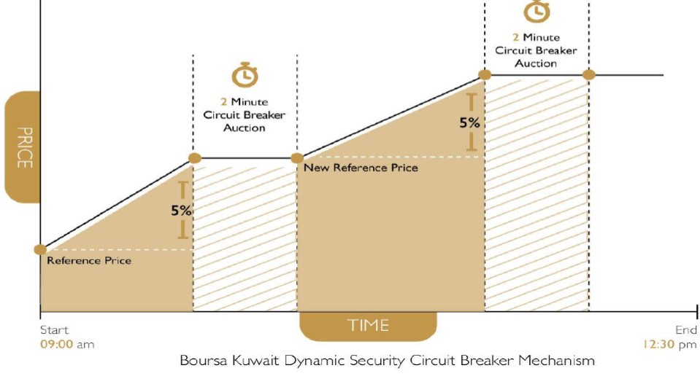
Circuit Breakers: Closer Look
10% now (28/04/2019)
Source: Boursa Kuwait

Slide 35
Circuit Breakers: Closer Look
Index-Level CBs
Objective
  Provide for a “cool off” period related to excessive market speculation or technical issues in a declining market.
Brief Description
Index Circuit Breakers
  Index circuit breakers apply to both Premier and Main markets.
  The following index circuit breakers will be set at the following levels:
    Level I CB: Decline of 5% - will trigger halt period of 15 minutes;
    Level II CB: Decline of 7% - will trigger halt period of 30 minutes;
    Level II CB: Decline of 10% - will trigger halt for the remainder of the trading day.
  CB triggers on different indices are independent of each other.
  If an index circuit breaker is in level I or level II of the halt and the halt coincides with the start of the closing auction, the halt will be cancelled and the constituents on the index will enter the closing auction event.
  Boursa Kuwait will amend these percentages periodically as it deems fit after CMA approvals.

Slide 36
Overview of Main Aspects of MD-2 Scope
1
Buy-in Board
2
3
Market Segmentation/New Indices
Circuit breakers
T+3 general security board
T+1 special buy-in board
Main
4
OTC platform for non-listed securities
5
Off-Market trades processing streamlined through automation

Slide 37
Overview of Main Aspects of MD-2 Scope
1
Buy-in Board
2
3
Market Segmentation/New Indices
Circuit breakers
T+3 general security board
T+1 special buy-in board
Main
4
OTC platform for non-listed securities
5
Off-Market trades processing streamlined through automation

Slide 38
Agenda
1- Market Development-1 Changes (Phase 1);
2- Market Development-2 Changes (Phase 2);
3- Market Development-3.1 Changes (Phase 3);
4- Country Classification;
5- Q&A.

Slide 39




Overview of Main Aspects of MD-3 Scope
1
Trade at Last session (TAL)
2
3
Short selling + Stock lending
Extra enhancements to off-markets trades
5
Introduction of REITs

Slide 40
Overview of Main Aspects of MD-3 Scope
1
Trade at Last session (TAL)
2
3
Short selling + Stock lending
Extra enhancements to off-markets trades
5
Introduction of REITs

Slide 41
Overview of Main Aspects of MD-3 Scope
1
Trade at Last session (TAL)
2
3
Short selling + Stock lending
Extra enhancements to off-markets trades
5
Introduction of REITs

Slide 42
Overview of Main Aspects of MD-3 Scope
1
Trade at Last session (TAL)
2
3
Short selling + Stock lending
Extra enhancements to off-markets trades
5
Introduction of REITs

Slide 43
Overview of Main Aspects of MD-3 Scope
1
Trade at Last session (TAL)
2
3
Short selling + Stock lending
Extra enhancements to off-markets trades
5
Introduction of REITs

Slide 44
Agenda
1- Market Development-1 Changes (Phase 1);
2- Market Development-2 Changes (Phase 2);
3- Market Development-3.1 Changes (Phase 3);
4- Country Classification;
5- Q&A.

Slide 45



Index Providers
Index Providers
What is the purpose indices?
1
Measure direction
Economic Indicators.
Benchmark for Performance
2
Basis for Products (index-linked investments)
Provide Benchmark
Research & Analysis
Roles
Types
3
Conduct Calculations
Broad Market Indices
Sector Indices
4
Strategy and Thematic Indices
License Indices

Slide 46
FTSE Country Classification Process
Engagement: Dialogue with relevant authority in the country;
Questionnaire: Quality of Markets matrix (next slide);
Review: FTSE Russell Country Classification Advisory Committee and FTSE Russell Policy Advisory Board
Decision: Watch List created / Upgrade or Downgrade.
Plan: Implementation timetable (if decision is to re-classify)
Frequency: Annual process
More details can be found at
http://www.ftse.com/products/downloads/FTSE_Country_Classification_Paper.pdf

Slide 47
Quality of Markets Criteria, 9/21 Criteria Must Be Met for Secondary Emerging Classification
 | Developed | Advanced Emerging | Secondary Emerging | Frontier
World Bank GNI Per Capita Rating
Market and Regulatory Environment
Formal stock market regulatory authorities actively monitor market (e.g., SEC, FSA, SFC) | X | X | X | X
Fair and non-prejudicial treatment of minority shareholders | X | X
No or selective incidence of foreign ownership restrictions | X | X
No objections or significant restrictions or penalties applied to the investment of capital or the repatriation of capital and income | X | X | X | X
Free and well-developed equity market | X | X
Free and well-developed foreign exchange market | X | X
No or simple registration process for foreign investors | X | X
Custody and Settlement
Settlement - Rare incidence of failed trades | X | X | X | X
Custody-Sufficient competition to ensure high quality custodian services | X | X | X
Clearing & settlement - T + 2 / T+3 | X | X | X | X
Settlement - Free delivery available | X
Custody - Omnibus account facilities available to international investors | X | X
Dealing Landscape
Brokerage - Sufficient competition to ensure high quality broker services | X | X | X
Liquidity - Sufficient broad market liquidity to support sizeable global investment | X | X | X
Transaction costs - implicit and explicit costs to be reasonable and competitive | X | X | X
Stock Lending is permitted | X
Short sales permitted | X
Off-exchange transactions permitted | X
Efficient trading mechanism | X
Transparency - market depth information / visibility and timely trade reporting process | X | X | X | X
Derivatives
Developed Derivatives Market | X
Source: FTSE Russell

Slide 48
FTSE Decision (Sept 2017)
The FTSE Russell Country Classification Advisory Committee endorsed the following criterion rating
changes:
  the criterion: ‘Clearing & Settlement – T+2 / T+3’ has been upgraded from “Restricted” to “Pass”, following the transition to a T+3 settlement cycle and the introduction of a Delivery versus Payment (DvP) model;
  the criterion: ‘Stock Lending is permitted’ has been upgraded from “Not Met” to “Restricted”, following the introduction of legislation which permits stock lending for a selected number of securities; and
  the criterion: ‘Short sales is permitted’ has been upgraded from “Not Met” to “Restricted”, following the introduction of legislation which permits short selling for a selected number of securities.

Slide 49
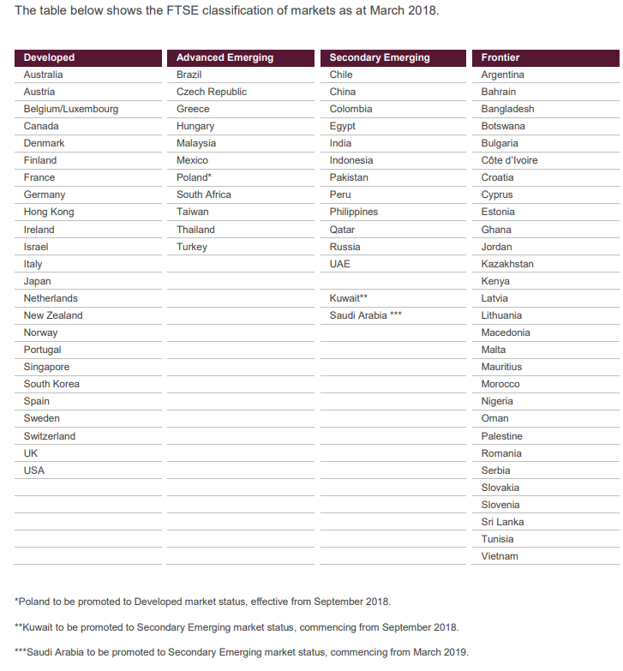
FTSE Classification of Markets
Source: FTSE Russell

Slide 50






Benefits of Market Classification Upgrade
Inflows from international investors
Increased transparency
Enhance country profile
Activate investor relations
Align with international standards
Improve liquidity
Broaden investor/capital base
Full disclosures
Improve country recognition

Slide 51
Kuwait transition to FTSE Russell index (GEIS)
1st tranche
2nd tranche
50%
50%
AUB | NBK
HUMANSOFT | KIB
ZAIN | KFH
AGLTY | INTEGRATED
BPCC | MEZZAN
NIND | WARBABANK
BOUBYAN | ALIMTIAZ
GBK
Sept 2018
Dec 2018
FTSE Russell Upgrade
Timeline
- Transition implemented over two 50% tranches.
Securities
Kuwait weight is 0.83% within FTSE Emerging All Cap indexes.
Semi-Annual Review
$1.5bn
Inflows
*
Estimated passive inflows into Boursa Kuwait
*Source: Based on trading around effective dates (Sept 18, Dec 18 and March 19)

Slide 52
Next Steps
1
Updates to index constituents (companies)
Criteria
Size
Free-Float
Liquidity
$3.4
bn
$1 bn
Market Cap
5%
0.04% Existing
Daily Volume
0.05% New
$0.29 bn
L M S

Slide 53
What’s Next?
1
Updates to index constituents (companies)
Securities list to be updated.
Inclusion of company is positive (diversification of capital / liquidity)
How can companies pursue inclusion to the index?
Useful read (FAQ document): Reclassification of Kuwait to Secondary Emerging Market Status
Link: http://www.ftse.com/products/downloads/FTSE_FAQ_Document_Kuwait.pdf

Slide 54
What’s Next?
2
Promotion? Demotion?
Kuwait must maintain satisfying the criteria to avoid demotion.
Kuwait needs to satisfy 4 additional criteria to be promoted to “Advanced Emerging” status.

Slide 55
MSCI
On 20th of June 2018, MSCI announced that the MSCI Kuwait Index will be included in the 2019 Annual Market Classification Review for a potential reclassification from Frontier Markets to Emerging Markets status.
MSCI: “since May 2017, a number of positive market reforms were implemented”
Three levels assessment:
  First: Economic Development.
  Second: Size and Liquidity Requirements.
  Third: Market Accessibility Assessment.

Slide 56
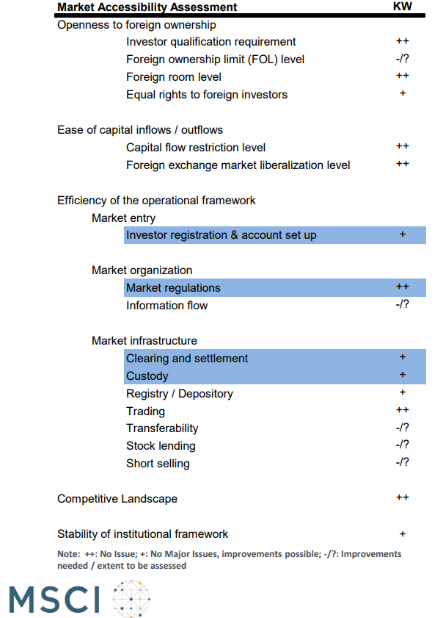
Market Accessibility Assessment - 2018
As captured from MSCI’s “CONSULTATION ON A MARKET
RECLASSIFICATION PROPOSAL
FOR THE MSCI KUWAIT INDEX” document

Slide 57
Agenda
1- Market Development-1 Changes (Phase 1);
2- Market Development-2 Changes (Phase 2);
3- Market Development-3.1 Changes (Phase 3);
4- Country Classification;
5- Q&A.

Slide 58

Thank you
Questions and Answers..

